Slide 1
JavaScript: Getting Started
INTRODUCTION TO JAVASCRIPT

Slide 2




JavaScript Applications
Web Pages
Business Apps
Utility Apps
Games

Slide 3
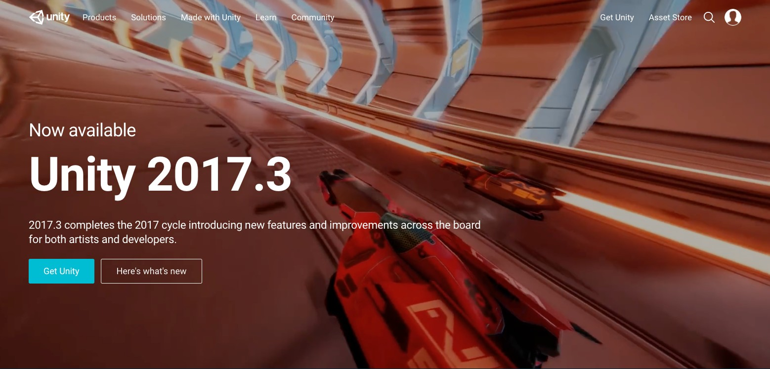

Slide 4
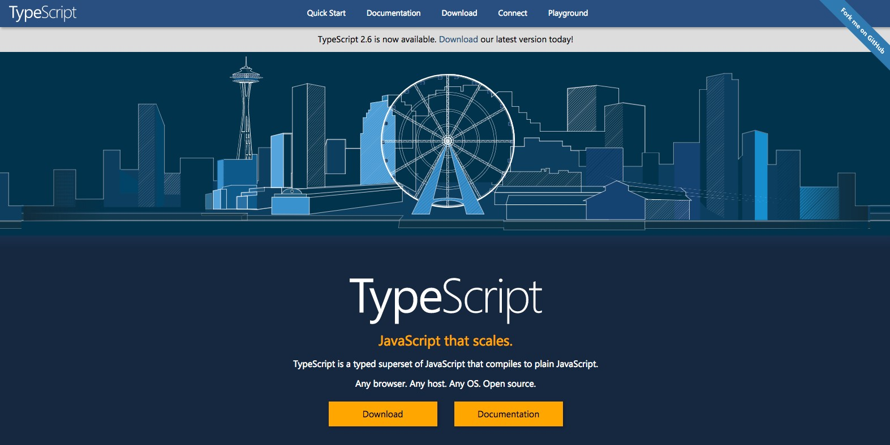

Slide 5

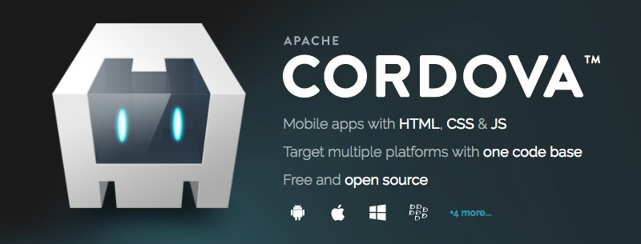


Slide 6



Slide 7



Slide 8


Slide 11


Slide 12


Slide 13
Learning JavaScript in Plunker

Slide 14
Plunker
plnkr.co

Slide 15
Hello World

